Slide 1


Visual Analytics Application for Video Game Sales Dataset
Exploring Insights for Developers, Publishers, and Marketers
Anastasiia Tykholiz (2184571)
A Modern Communications Company
A Modern Communications Company
Daria Serhiienko (2184570)
Oleksandra Panibratets (2187414)
A Modern Communications Company
A Modern Communications Company

Slide 2


Abstract
This project aims to create a visual analytics tool for exploring video game sales data. Designed for publishers, developers, and analysts, it features interactive visualizations like Time-Series Graphs, Heatmaps, and PCA plots to uncover trends, patterns, and actionable insights. The tool simplifies data exploration, supports strategic decision-making, and enhances market understanding.

Slide 3



Goals:
Provide deep insights through layered analysis.
Help users identify patterns.
Answer real business questions in the gaming industry.

Slide 4
Data Structure
The dataset includes the following key features:
Sales Data: Regional sales (NA, EU, JP, Other) and global sales.
01
Game Title: Name of the video game.
05
Platform: Gaming platform(s) for which the game was released (e.g., PlayStation, Xbox, PC).
02
06
Release Year: Year the game was launched.
Genre: Category of the game (e.g., Action, Sport).
Rank: Global ranking of the game.
03
07
Preprocessing Steps:
Handling missing values
Removing duplicates
04
Publisher

Slide 5
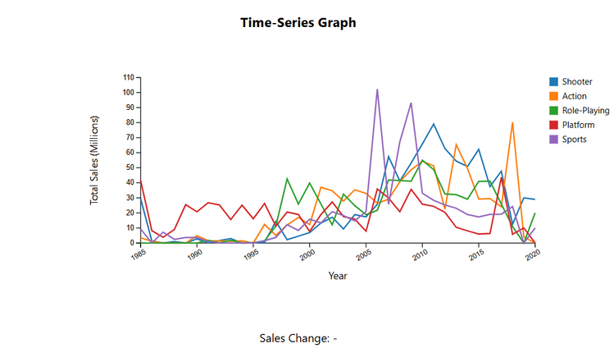
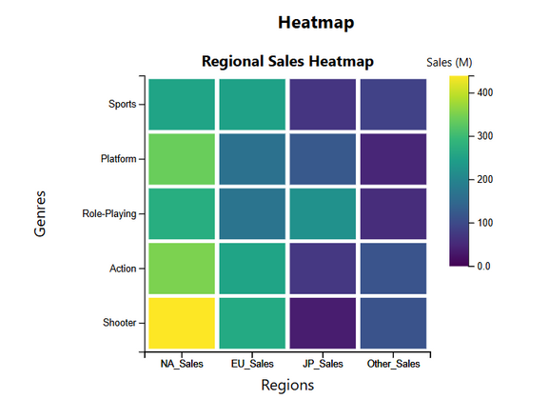
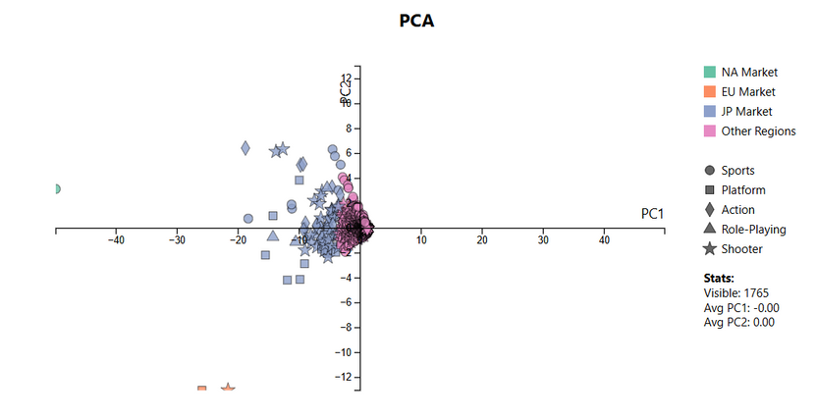
Chosen Visualizations
Time-Series Graph
Heatmap
PCA Scatterplot

Slide 6

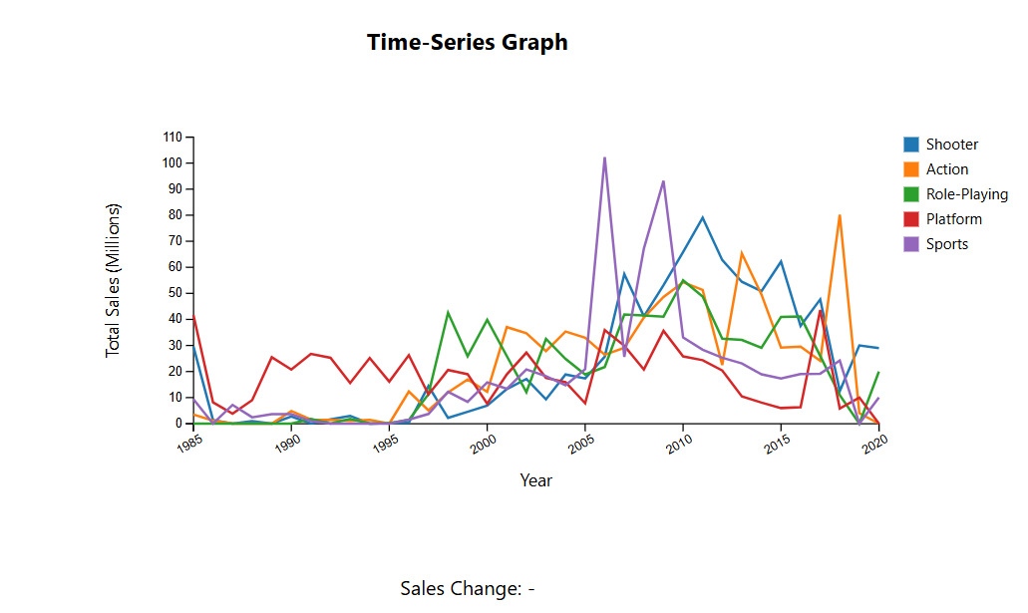
Time-Series Graph
Description:
Tracks sales trends over time for the top 5 genres or platforms.
Key Features:
X-axis: Time (years)
Y-axis: Global Sales
Lines: Different genres
Use Cases:
Publishers: Understand historical popularity of genres.
Developers: Choose trending genres for future games.
Analysts: Study market shifts over time.
Example:
"The graph shows Sports sales peaked from 2005 to 2010."
Example Use Case: Developers choosing a genre for their next game based on past performance.
Why It Matters:
Reveals when genres rise or decline in popularity.
Crucial for planning marketing campaigns and game releases.

Slide 7
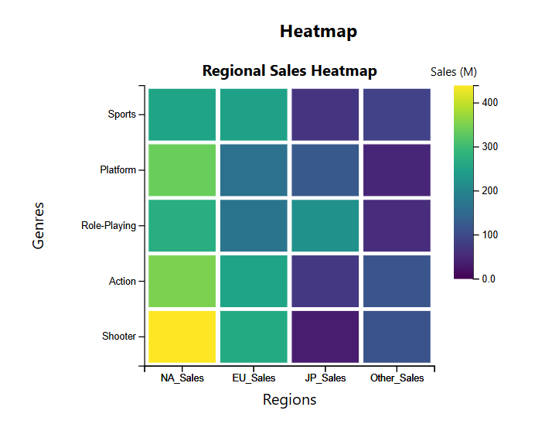
Heatmap
Description:
The Heatmap helps us understand which regions had the highest sales for a selected time period from the Time-Series Graph
Key Features:
Rows: Genres
Columns: Regions (NA, EU, JP, Other)
Colors: Intensity of sales
Use Cases:
Marketers: Identify strong-performing regions for specific genres.
Publishers: Tailor promotional efforts to high-sales regions.
Example:
"The heatmap shows that Shooter genre is the most popular in the US"
Why It Matters:
Visualizes sales distribution across regions.
Complements Time-Series analysis by adding geographic context.
Example Use Case: Marketers planning regional promotional strategies for upcoming releases.
Relation to Time-Series:
Time-Series highlights a genre’s popularity; Heatmap shows where it’s popular.

Slide 8
What does the analysis reveal about regional sales trends?
Regional preferences vary widely:
North America prefers shooters and sports games.
Japan leans heavily towards RPGs.
Europe has diverse preferences with balanced genre popularity.

Slide 9
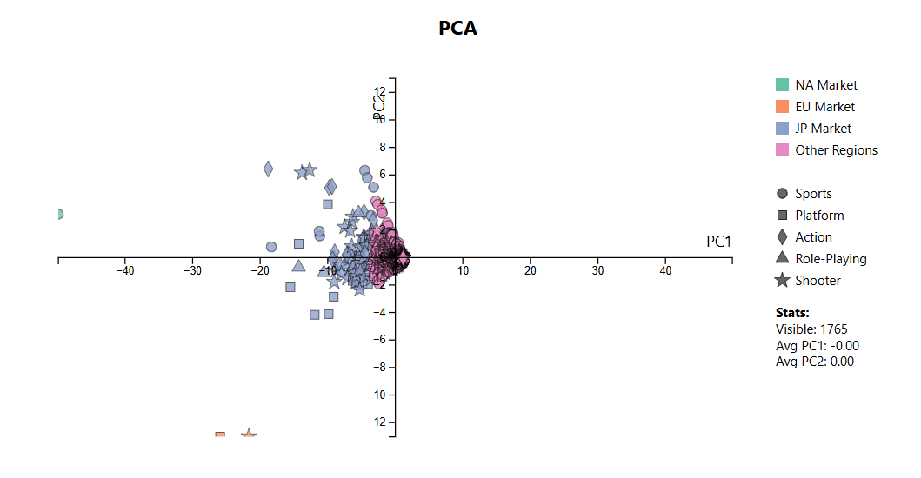
PCA Scatterplot
Description:
Principal Component Analysis (PCA) is a technique used to reduce data complexity. It helps visualize high-dimensional data by projecting it onto a two-dimensional space. In this case, we use PCA to analyze video game sales and market segmentation.
Key Features:
Point color = The region where the game sold the most (NA, EU, JP, Other).
Point shape = The platform the game was released on (e.g., PS, DS, Wii, etc.).
Distance between points = Sales similarity. If games are clustered together, it means they share market trends.
Use Cases:
Developers: Compare games to identify potential platforms.
Publishers: Explore cross-platform audience overlaps.
Analysts: Understand regional and platform dynamics.
Example Use Case: Publishers deciding whether to port a game to another platform or expand into a new region.
Insights Provided:
Similarities between platforms and genres.
Regional trends and opportunities for expansion
Why It Matters:
Identifies relationships and sales trends that are not obvious in raw data.
Saves time by simplifying complex data comparisons.

Slide 10
How does it help with decision-making?
This graph helps assess market strategy for platforms and genres. For example:
Should a game be released on another platform? → If a DS game is clustered near 3DS games, it might be worth porting.
Does a game have potential in a new region? → If a European game is grouped with top-selling North American games, it may succeed in that market.
Which platforms have similar audiences? → Clusters of points suggest that platforms share a user base.

Slide 11
How do these graphs help in ways a table can't?
Tables require analyzing large amounts of raw data, which is time-consuming and difficult to interpret. Our visualizations simplify this process, allowing users to quickly identify trends and patterns.

Slide 12


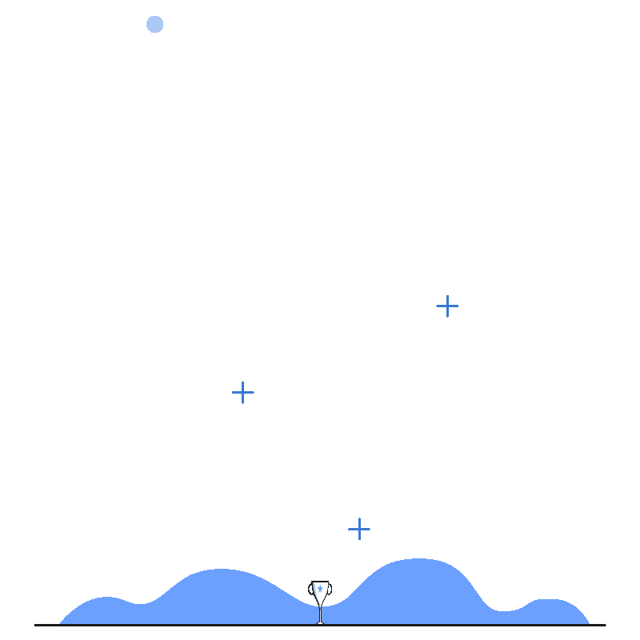
Use Cases for the Target Audience
Publishers:
Decide which genres/platforms to invest in.
Developers:
Choose platforms and genres for new games.
Marketers:
Plan regional promotional strategies.
Example:
"Should we release an RPG in the US? Use the Time-Series and Heatmap to decide."

Slide 13


How Visualizations Work Together
Time-Series: Highlights when trends occur.
Heatmap: Shows where trends are strongest.
PCA: Explains why trends occur through market patterns.
Example:
"The Time-Series graph shows RPGs were popular in 2010-2020, Heatmap shows Japan as the key region, and PCA highlights RPGs’ success on platforms like DS."

Slide 14
Who are the real users?
Gaming Companies:
Ubisoft: Uses data to decide which genres to prioritize.
Electronic Arts (EA): Determines regional marketing strategies.
Sony Interactive Entertainment: Identifies platform-specific trends for PlayStation.
Publishers and Distributors:
Nintendo: Plans game releases and evaluates platform-specific sales.
Activision Blizzard: Analyzes trends to allocate resources effectively.
Retailers and E-commerce Platforms:
GameStop: Decides which games to stock based on regional popularity.
Amazon: Uses sales data to optimize gaming product recommendations.

Slide 15
What improvements could be made to the application?
Future enhancements could include predictive modeling for sales forecasts, integration with real-time data streams, and expanding the dataset with more granular attributes like user demographics or gameplay hours.

Slide 16


Conclusion
This visual analytics application empowers users to make informed decisions by transforming complex sales data into actionable insights. Through intuitive and interactive visualizations, the tool bridges the gap between raw data and strategic planning, catering to the needs of the gaming industry's key stakeholders.
Lets move on to demonstrating user interaction during the presentation to highlight the interactivity and usability of the system

